Slide 1


PROJECT
LINKEDLIST
OOP Project, November-December 2021

Slide 2

TABLE OF CONTENTS
01
02
03
04
05
06
Objective
Requirements
Tech Stack
UML Case
Usecase
Implementation

Slide 3
OBJECTIVE
The project aims and objectives that will be achieved after the completion of this project are discussed in this subchapter. The aims and objectives are as follows:
• Create a simple landing page or a single link that hosts multiple links.
• The link can be shared on Facebook posts, your Instagram bio, your profile on Twitter, along many other platforms.
• Depending on user subscription, they can change fonts, add animated backgrounds, highlight priority links, get detailed analytics.
• The free version of the link stack will have limited functionality and will not allow users to add much branding. However, users can add a profile picture, get short analytics and change the color of the background to one of our presets.

Slide 4









05
linklive.live/user
onelink
Bio
Dashboard
Other Features
One Link to go to all platforms.
To maintain all links by user
URL Shortner
Analytics
Special Links
Portofolio
Personal Links
Project LinkedList
OOP PROJECT

Slide 5
REQUIREMENTS
1. A user can register to the website.
2. A user can choose username (that will be the url)
E.g
Username = siddhant
linktree.com/siddhant
3. A user will have to follow authentication process to access his dashboard section.
4. A user can manage his profile from dashboard section
h. A user can remove branding of (LINKStack ) from his profile page (PREMIUM)
i. A user can share his profile
i. A user can share his profile to particular platform
ii. A user can also generate QR Code of his profile.
a. A user can add photo to his profile
b. A user can add profile title
c. A user can add his biography in profile section
d. A user can add links to his profile
e. A user can see the total no of views on his profile
f. A user can see the total no of clicks on his links (A user can also see no of clicks on his particular link (PREMIUM) )
g. A user can customize his profile page
i. A user can change theme (colour, background) of his profile page
ii. A user can rearrange the links on his profile page

Slide 6











TECH STACK
06
BACKEND
VERSION
CONTROLLING
NodeJS
DATABASE
FRONTEND
HTML
CSS
JavaScript
MongoDB
Bootstrap
Project LinkedList
OOP PROJECT

Slide 7
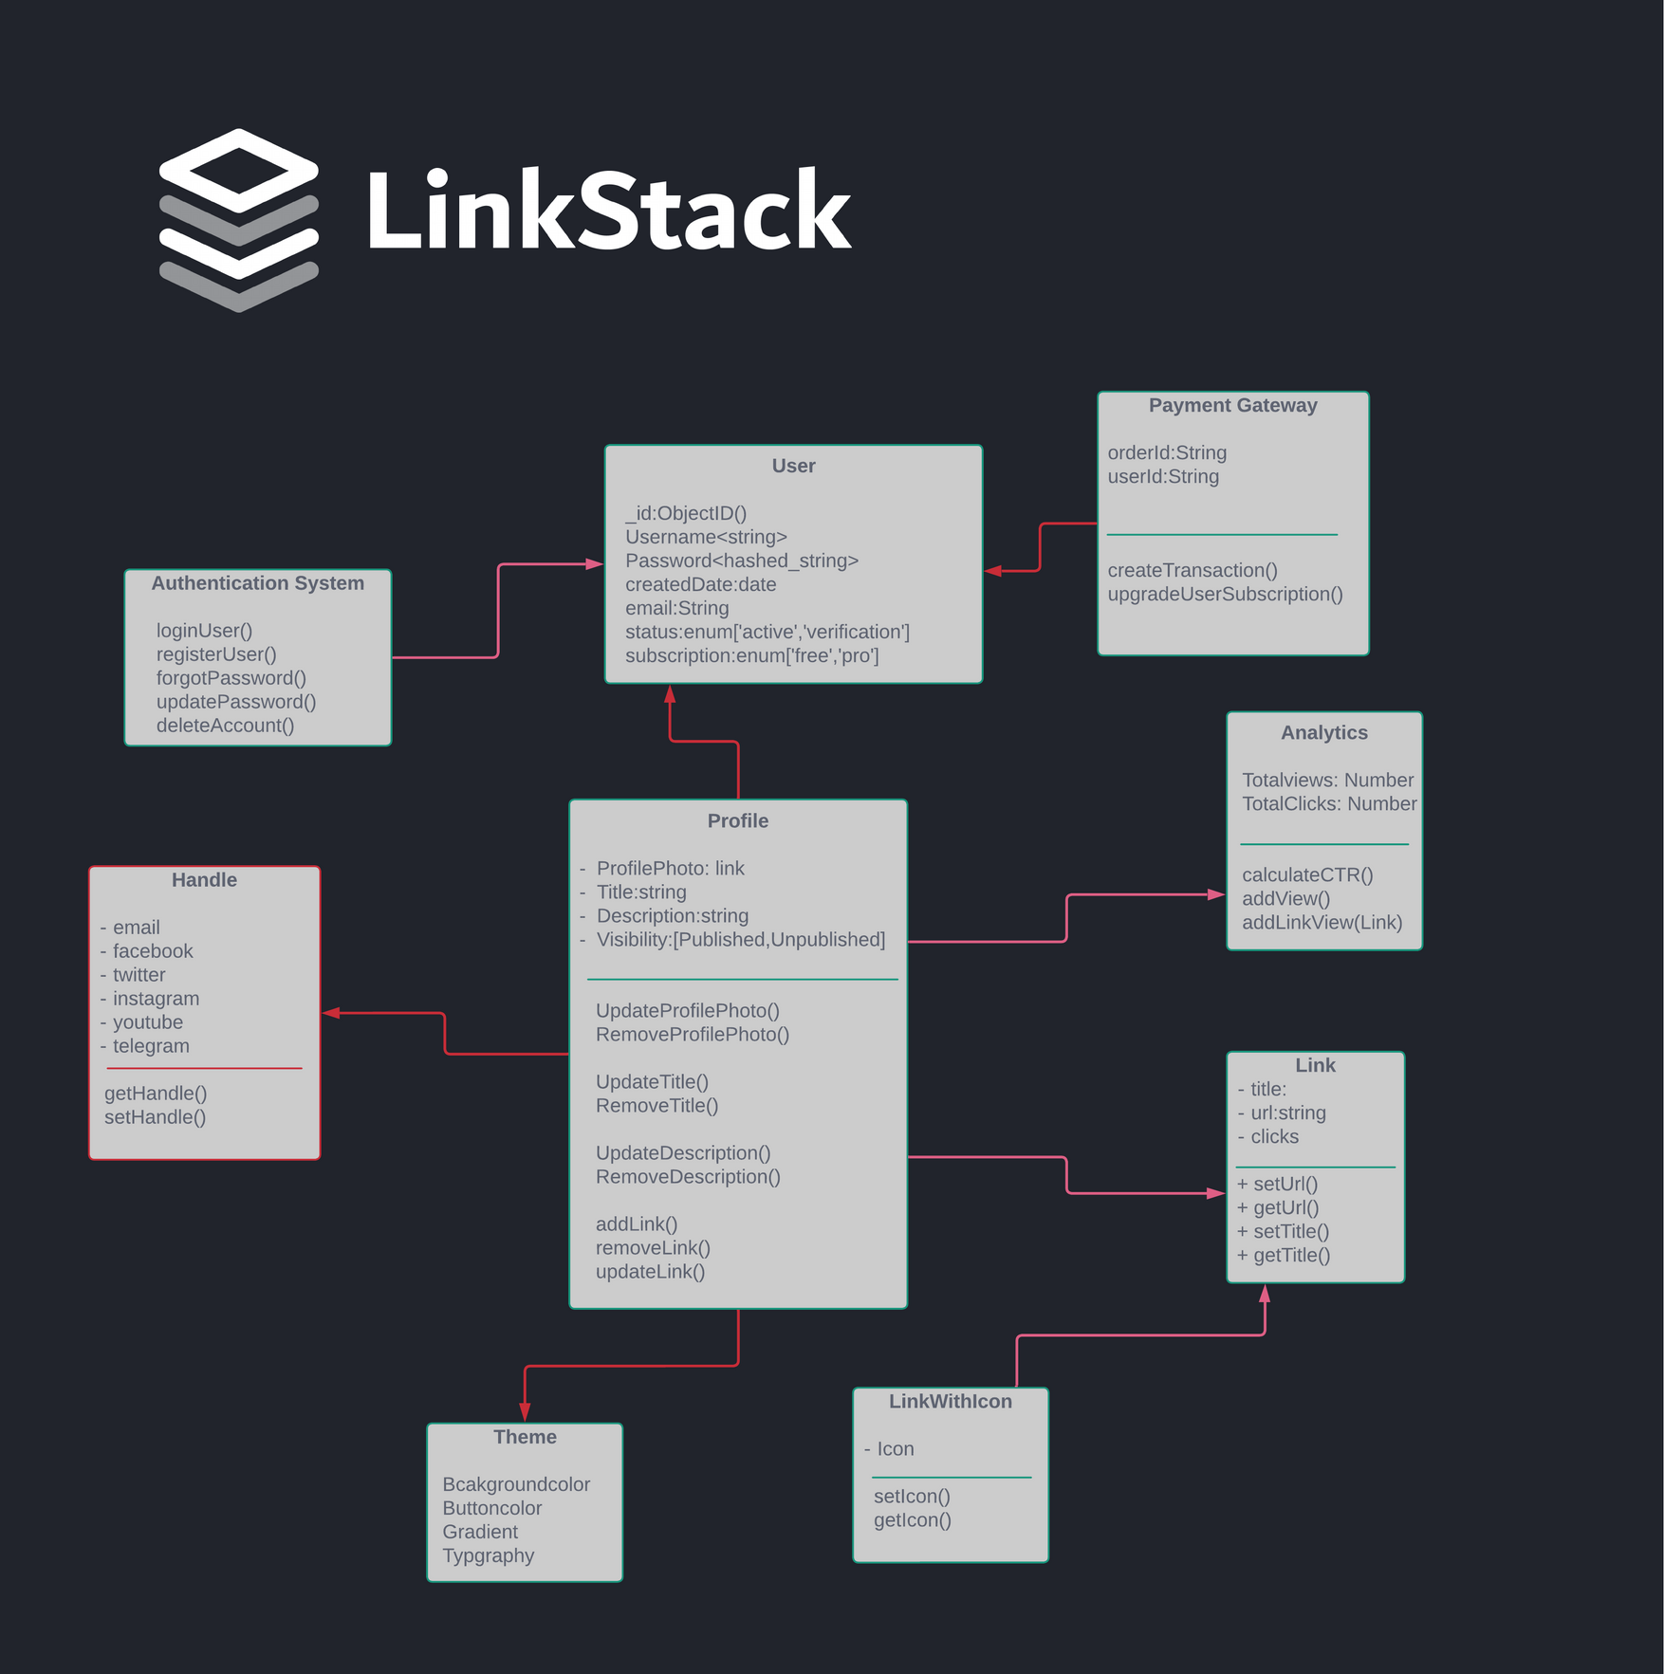
UML

Slide 8
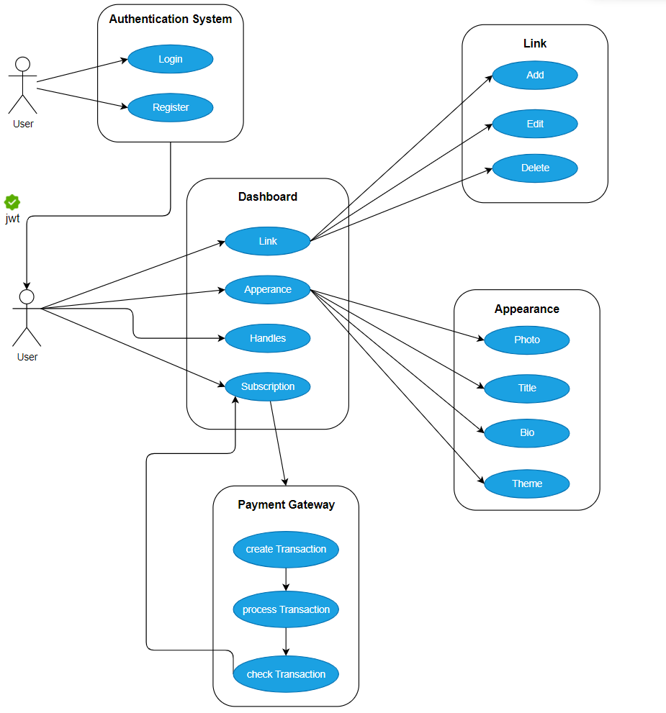
USECASE

Slide 9
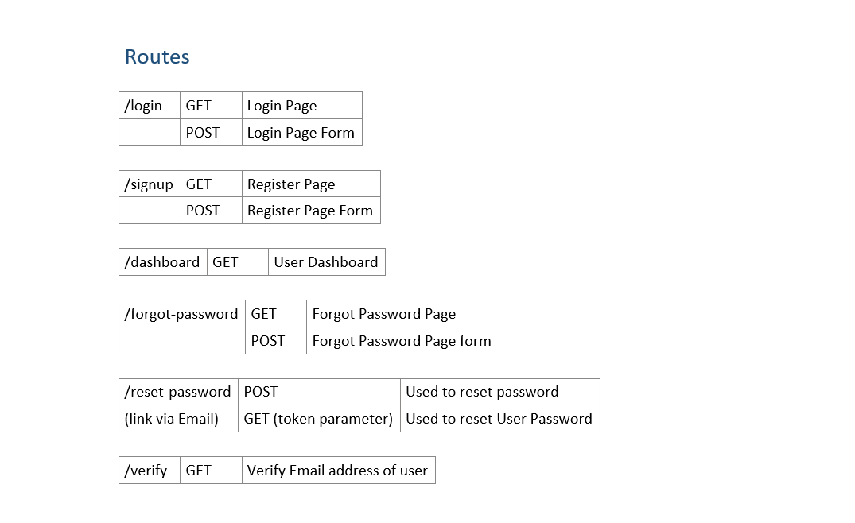
API ROUTES

Slide 10
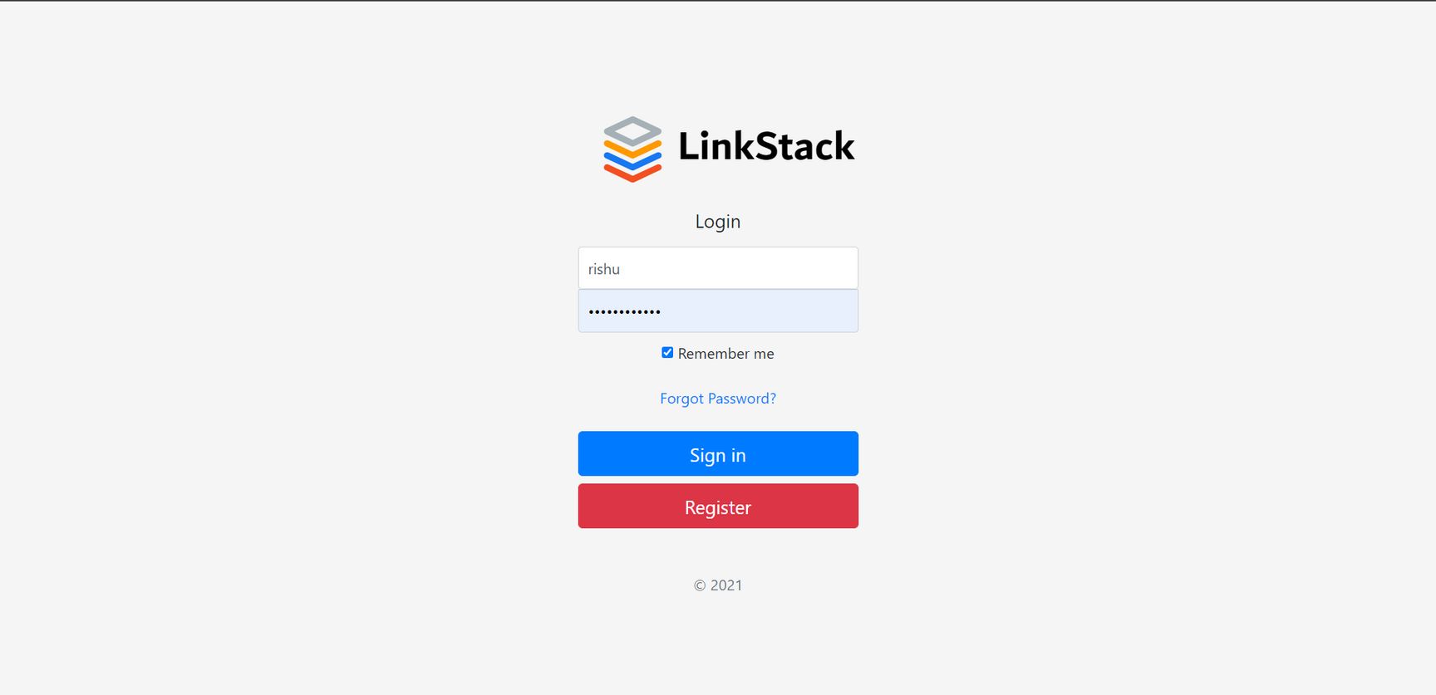

Slide 11


